Slide 1
Language History and Change

Slide 2
Family Trees

Slide 3
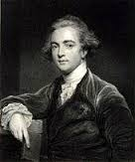
Sir William Jones

Slide 4
Sir William Jones suggested that a number of languages from very different geographical areas must have some in common.

Slide 6
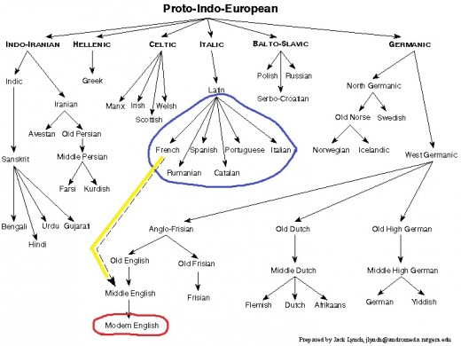

Slide 7
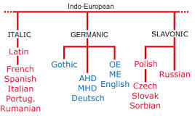

Slide 8
Family Connections Sanskirt Latin Greek pitar pater pater ( father ) bhratar frater phrater ( brother )

Slide 9
Cognates A cognate of a word in one language is a word in another language that has similar form and is or was used with a similar meaning, as father , mother , friend, brother ( English ) vater , mutter, freund , bruder ( German )

Slide 10
Comparative Reconstruction It is a procedure that is used to reconstruct the original ( proto ) form in the common ancestral language. There are two principles : - majority principle - most natural development principle

Slide 11
Sound Reconstruction Italian Spanish French cantare cantar chanter ( sing ) catena cadena chaine ( chain ) cavallo caballo cheval ( horse )

Slide 12
Word Reconstruction mube mupe mup ---------- ( stream ) abadi abati apat ---------- ( rock ) agana akana akan ---------- ( knife ) enugu enuku enuk --------- ( diamond )

Slide 13
Language Change It is variation over time in a language's phonetic, morphological, semantic, syntactic , and other features.

Slide 14
Causes of language change - Economy - Analogy - Language contact - The medium of communication - Cultural environment - Migration / Movement - Invasion / colonialism

Slide 15
Old English ( Anglo-Saxon ) English language comes from the Germanic languages spoken by three tribes from northern Europe in the fifth century ; Angles , Saxons and Jutes. In eighth to tenth centuries , the language ( Old Norse ) of Viking who settled in the coastal regions of Britain was the fourth source for English.

Slide 16
Anglo-Saxon refers to the period of the history of the part of Great Britain that became known as England. Anglo-Saxon is a general term referring to the Germanic peoples who came to Britain during the 5th and 6th centuries, including Angles, Saxons, Frisii and Jutes. The term also refers to the language spoken at the time in England, which is now called Old English.

Slide 17
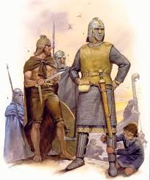
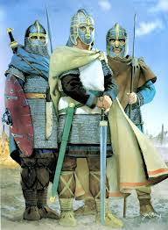
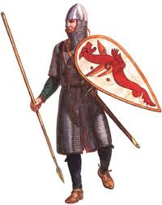
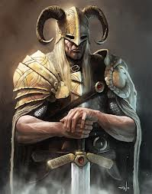
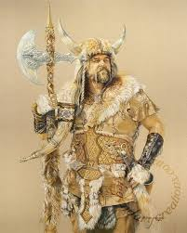
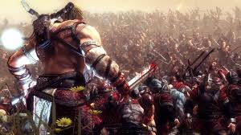

Slide 18
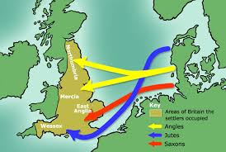

Slide 19
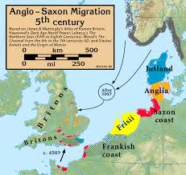

Slide 20
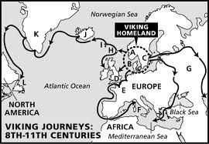

Slide 21
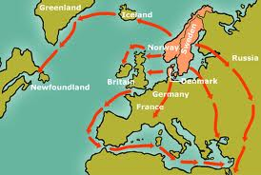

Slide 22
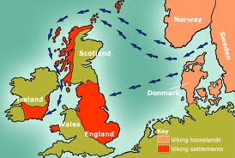

Slide 23
Middle English The event that marks the end of the Old English period and the beginning of the Middle English period is the arrival of the Norman French in England and their victory at Hastings under William the Conqueror in 1066.

Slide 24
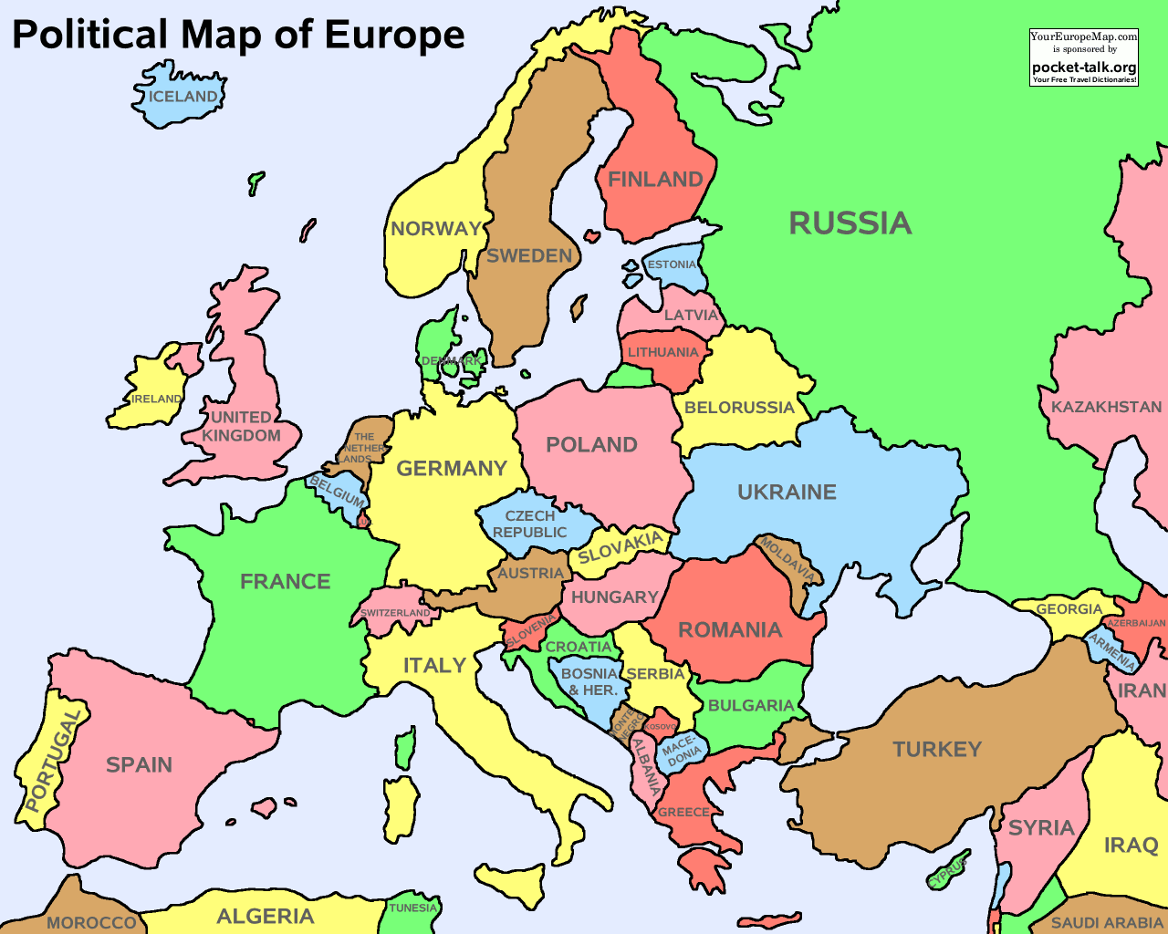

Slide 25
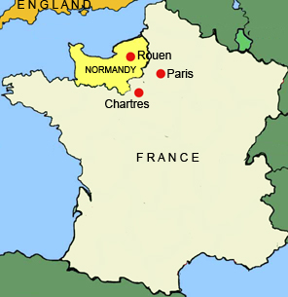

Slide 26
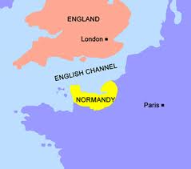

Slide 27
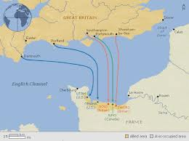

Slide 28
French became the language of nobility , the government, the law and civilized life in England. The language of peasants remained English . The peasants worked on the land and reared sheep, cows and swine.

Slide 29
Sound Changes Some changes occurred from Middle to Modern English. Some sounds disappeared resulting in the ‘silent letters’ . Word initial velar stop / K / and / g / are not pronounced before / n / .

Slide 30
Metathesis reversal in position of two sounds in a word , frist first hros horse Epenthesis addition of a sound to the middle of a word, spinel spindle timr timber Prothesis addition of a sound to the beginning of a word, schola escuela

Slide 31
Syntactic Changes Changes that involve differences between the structure of sentences in Old and Modern English. - The subject may follow the verb or the object could be placed before the verb in Old English . - Double negation was possible in Old English. - Loss of a large number of inflectional affixes from many parts of speech.

Slide 32
Semantic Changes - Borrowing Arts (e.g. concerto, allegro, tempo, aria, opera, soprano) are borrowed from Italian and ‘ballet’ from French. Business - English exports English terms to other languages in business and technology (examples le meeting to French). Philosophy - derive from Greek dominance in philosophy, mathematics, linguistics, economic theory. Examples include democracy, theory and so on.

Slide 33
Religion - religions may carry with them a large number of technical terms from the language of the originating culture. For example: Arabic (Islam) - Arabic words like hijab Greek (Christianity) - Likewise Greek words like baptisma have entered many languages as baptism or similar. Hebrew (Judaism) - Some terms in the Hebrew Bible have been carried into other languages due to being borrowed rather than translated in Bible translations. For example Hebrew shabbat ("day of rest" שַׁבָּת) has been borrowed into most languages in the world: in Greek the word is Σάββατο; Latin sabbato; Spanish sábado; and in English Sabbath.

Slide 34
Latin (Catholicism) - Latin words like missa and communio have entered English as mass and communion. Sanskrit (Hinduism) - words like guru (teacher) Science (Latin) - medicine (itself a Latin loanword) uses a large vocabulary of Latin terms (sternum, appendix), as a result of medieval advances in medical science being conducted in Latin - even if some of the earliest Latin medical texts were translations from Greek and Arabic.

Slide 35
Broadening The process by which the meaning of a word becomes broader or more inclusive than its earlier meaning. Also known as generalization or extension. ‘holy day’ is nowadays used to refer to ‘holiday’ or any general break from work.

Slide 36
narrowing takes place when a word comes to refer to only part of the original meaning. The history of the word hound in English neatly illustrates this process. It was the generic word for any kind of dog at all. In German, where the word Hund simply means 'dog.' Over the centuries, however, the meaning of hund in English has become restricted to just those dogs used to chase . Example - wife’ could be used to refer to any woman .

